Slide 1



AI-Powered Signature Verification System ✒️
This presentation details an innovative deep learning approach to digital signature verification. We explore the implementation of a Siamese network with Bidirectional LSTM layers, designed to analyze the dynamic properties of signatures for robust authentication.
Team Name – 404 Found
Raghav Kapoor, Aditya Agrawal and Jayanth Siddalingappa

Slide 2
Agenda
Unlocking Signature Authenticity
01
02
Introduction to Biometric Signature Verification
Core Components & Key Features
The challenge of authenticating dynamic digital signatures.
Deep dive into the Siamese Network and dynamic feature analysis.
03
04
End-to-End Workflow & Methodology
Model Architecture & Training
From synthetic data generation to explainable AI.
Understanding the Bidirectional LSTM and contrastive loss.
05
06
Prediction, Explainability & Results
Conclusion & Next Steps
Interpreting model outputs and XAI reports.
Summarizing key insights and future directions.

Slide 3
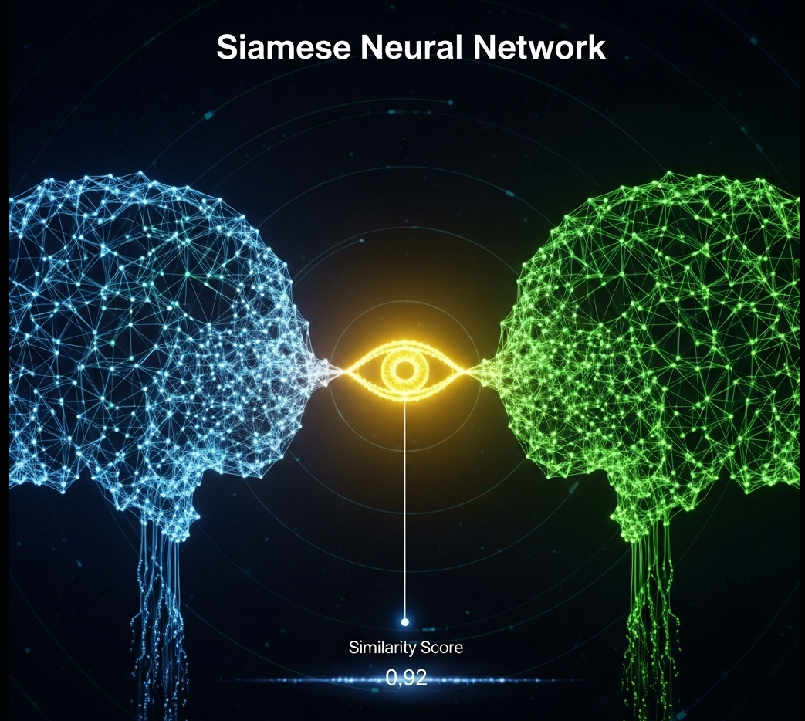

Core Innovation
Dynamic Feature Analysis with Siamese Networks
Our system leverages a Siamese network architecture, a powerful tool for similarity learning. Unlike traditional classification, a Siamese network learns to differentiate between highly similar inputs by comparing them directly. This is crucial for signature verification, where subtle dynamic variations distinguish genuine signatures from skilled forgeries.
The network employs shared weights across its two branches, ensuring that both signatures in a pair are processed identically, producing comparable embeddings.

Slide 4




Key Features
Unpacking the System's Capabilities
Dynamic Feature Analysis
Synthetic Data Generation
The model analyzes not just the signature's appearance, but its inherent dynamics: X-Y coordinates, pressure, and time delta (dt) between points. This captures the unique "rhythm" of a signature, making it resilient against static forgeries.
To overcome data privacy and scarcity, a robust script generates a complex synthetic dataset. It simulates diverse signature styles and natural variations for multiple users, providing ample training data for the deep learning model.
Explainable AI (XAI) Reports
End-to-End Workflow
The system generates detailed 2x2 comparison reports using Occlusion Analysis. This visualizes critical signature regions influencing the model's decision, enhancing transparency and trust in the verification process.
A comprehensive Jupyter Notebook encapsulates the entire process: from data creation and model definition to training, evaluation, and final prediction analysis. This ensures reproducibility and ease of use.

Slide 5

Workflow
The Signature Verification Pipeline
Pre-process
Siamese LSTM
Compare Features
Decide Outcome
The workflow begins with dynamic signature data, which undergoes pre-processing before being fed into the Siamese LSTM Network. The core comparison then determines authenticity based on calculated Euclidean distance against a predefined threshold.

Slide 6
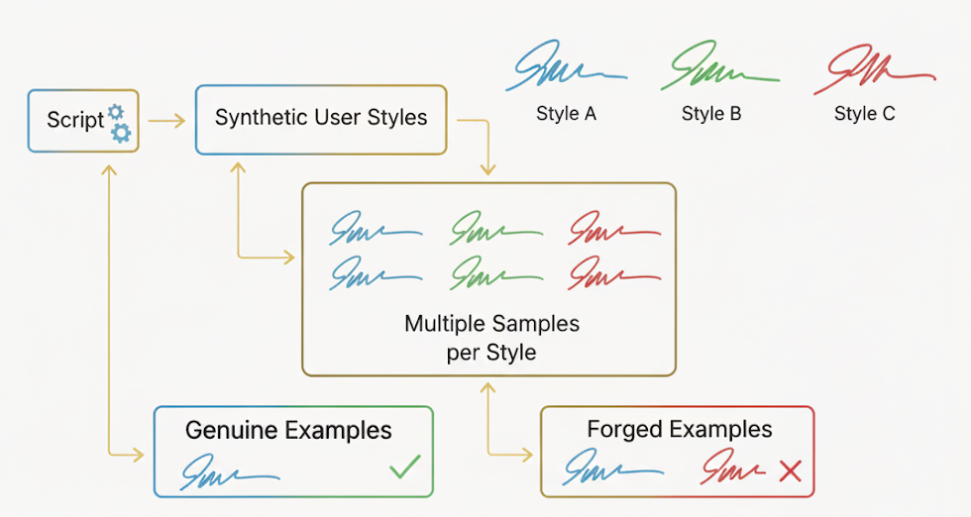
Data Strategy
Synthetic Data Generation & Preparation
Given the sensitive nature and scarcity of real signature data, our project employs a synthetic data generation approach. A dedicated script creates unique "styles" for different users, and then generates multiple signature samples for each style. This allows for controlled simulation of genuine variations within a user's signature.
These synthetic samples are then carefully paired into:
Genuine Examples: Pairs of signatures from the same synthetic user.
Forged Examples: Pairs of signatures from different synthetic users.
All generated signature sequences are padded to a uniform length (MAX_LEN) to ensure compatibility with the recurrent neural network architecture.

Slide 7
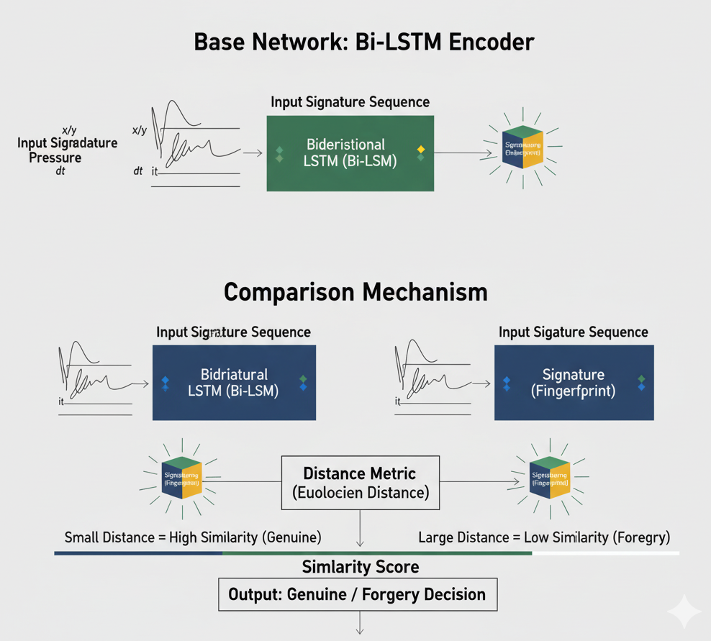

Model Deep Dive
Siamese Network Architecture
Base Network: At the heart of our Siamese network is a Bidirectional Long Short-Term Memory (Bi-LSTM) model. This network acts as an encoder, processing a single signature sequence (x, y, pressure, dt) and transforming it into a fixed-size numerical representation, often referred to as an "embedding" or "fingerprint." The Bi-LSTM's ability to process sequences in both forward and backward directions allows it to capture comprehensive temporal dependencies within the signature.
Comparison Mechanism: To compare two signatures, both are fed independently through the same base Bi-LSTM network. The similarity between the two resulting embeddings is then quantified by calculating their Euclidean distance. A smaller distance indicates higher similarity, suggesting a genuine pair, while a larger distance points to a forgery.

Slide 8
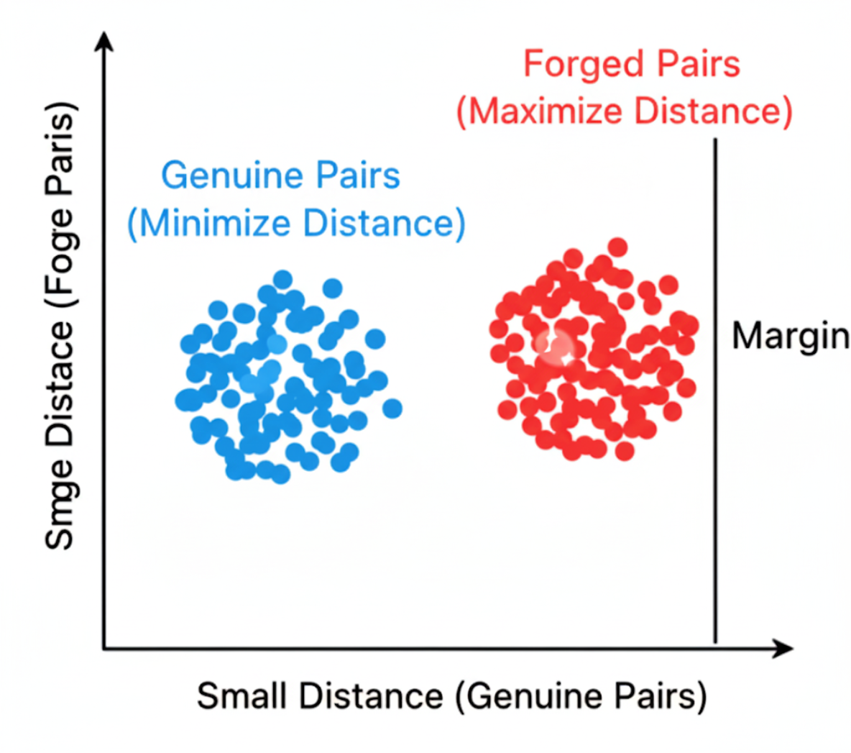
Training Strategy
Contrastive Loss for Similarity Learning
The Siamese network is trained using a contrastive loss function. This specialized loss is critical for similarity learning tasks. Its primary objective is to:
Minimize the Euclidean distance between the embeddings of genuine signature pairs (i.e., signatures from the same user).
Maximize the Euclidean distance between the embeddings of forged signature pairs (i.e., signatures from different users), ensuring a margin of separation.
This training methodology forces the network to learn robust features that can effectively discriminate between subtle variations in genuine signatures and the distinct differences found in forgeries.

Slide 9

Evaluation & Interpretability
Prediction & Explainable AI Reports
Prediction Mechanism
Occlusion Analysis Heatmap
Comprehensive Report
Once trained, the model outputs a distance score for any new signature pair. This score is then compared against a predefined decision threshold. If the distance is below the threshold, the pair is classified as "Genuine"; otherwise, it's deemed "Forged."
The detailed report includes the final prediction verdict, the raw distance score, and quantitative comparisons of dynamic statistics (speed, pressure profiles) between the two signatures. This provides a holistic view for forensic analysis.
A key component of the XAI report is the Occlusion Analysis. This generates a heatmap overlaid on the signature path, visually highlighting which parts (e.g., specific strokes or curves) were most critical and influential in the model's decision-making process.

Slide 10
Conclusion & Usage
Summary and Future Work
Key Takeaways
How to Use
Robust Verification: Dynamic features and Siamese networks offer superior forgery detection.
The complete project is available as a self-contained Jupyter Notebook.
Data Efficiency: Synthetic data generation addresses real-world privacy constraints.
Clone Repository: git clone https://github.com/aadityaagrawal/YG-Hackathon.git
Transparent Decisions: XAI reports provide crucial insights into model reasoning.
Install Dependencies: pip install numpy tensorflow matplotlib scikit-learn
Future Directions
Run Notebook: Open 404-FOUND_YI_HACKATHON_FINAL.ipynb in a Jupyter environment (Lab/Colab) to execute the full workflow.
Training on the real-world data for better efficiency.
Integration with hardware for real-time capture.
Exploration of other biometric modalities.
Optimize for mobile and edge devices.

Slide 11



